Slide 1
Math 769: Statistical Learning

Slide 2
Vapnik–Chervonenkis (VC) Dimension
Shahrzad Jamshidi, PhD

Slide 3
Last Time
We discussed the minimum description length, a metric that prioritizes compression.
We stated this metric is equivalent to BIC.

Slide 4
Objectives
State what VC Dimension computes.
Provide an example with linear regression.

Slide 5
VC Dimension and Shattering
Named after Vladimir Vapnik and Alexey Chervonenkis,
Quantifies the complexity of a model in terms of its ability to “shatter,” or perfectly classify, sets of points.
A model can shatter a set of points if, for all possible labelings of these points, there exists a function in the class that can classify the points perfectly.

Slide 6
VC Dimension Definition
The VC dimension of a family of functions is the largest number of points (in some configuration) that can be shattered by its members.
Note that this complexity corresponds not to any one model, but an entire family of them.

Slide 7
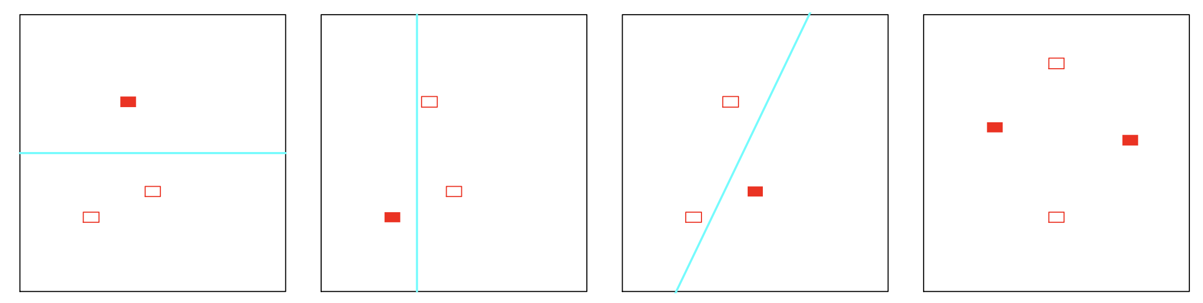
Shattering Visually
Below is an example of four points and the cases for line shattering.
In the last square, a single line cannot separate (i.e., shatter) the two sets.
Hence a linear model has VC dimension 3--the largest set it can shatter.

Slide 8
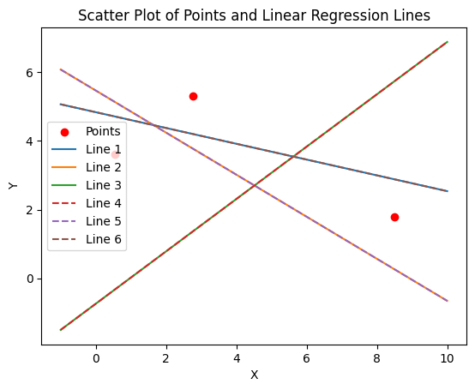
Coding Example
In our coded example, we set up linear regression and logistic regression to consider how many points it can separate.
Our code will even display the specific lines for the given dataset illustrating all possible splits.

Slide 9
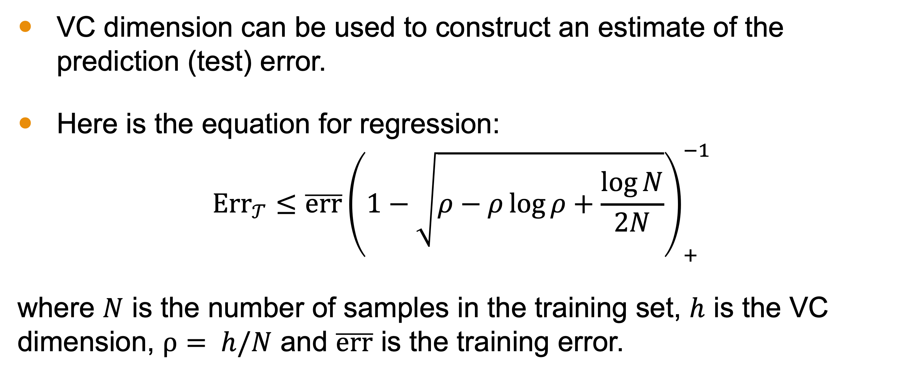
VC Dimension to Estimate Prediction Error
VC dimension can be used to construct an estimate of the prediction (test) error.
Here is the equation for regression:
$${\text{Err}}_{𝒯}≤\overline{err}{\left(1−\sqrt{ρ−ρ\log{ρ+\frac{\log{N}}{2N}}}\right)}_{+}^{−1}$$
where $N$ is the number of samples in the training set, $h$ is the VC dimension, $ρ= h/N$ and $\overline{err}$ is the training error.

Slide 10
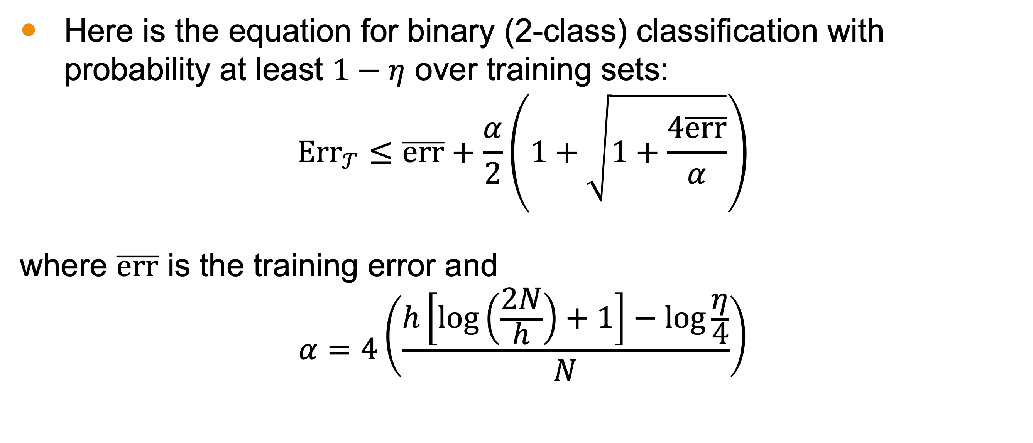
VC Dimension to Estimate Prediction Error
Here is the equation for binary (2-class) classification with probability at least $1−η$ over training sets:
$${\text{Err}}_{𝒯}≤\overline{err}+\frac{α}{2}\left(1+\sqrt{1+\frac{4\overline{err}}{α}}\right)$$
where $\overline{err}$ is the training error and
$$α=4\left(\frac{h\left[\log\left(\frac{2N}{h}\right)+1\right]−\log{\frac{η}{4}}}{N}\right)$$

Slide 11
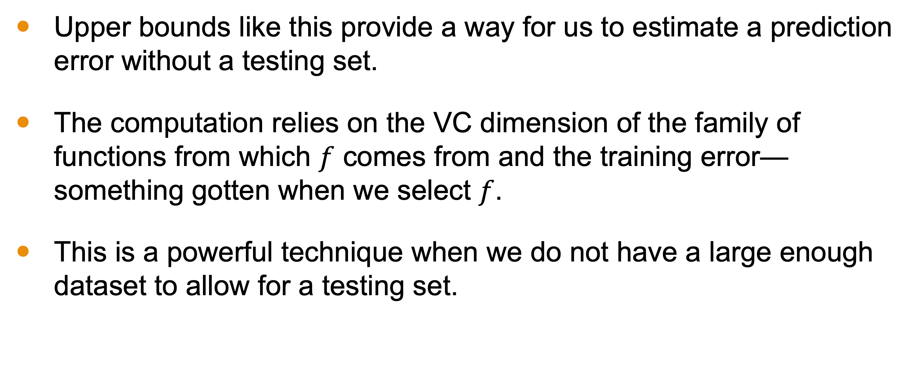
Utility
Upper bounds like this provide a way for us to estimate a prediction error without a testing set.
The computation relies on the VC dimension of the family of functions from which $f$ comes from and the training error—something gotten when we select $f$.
This is a powerful technique when we do not have a large enough dataset to allow for a testing set.

Slide 12
Conclusion
VC Dimension looks at the family of functions a model comes from.
It characterizes the complexity of the family of functions by considering the maximum number of points it can perfectly shatter.
This provides a measure for the complexity of the model.
The VC dimension is 3 for linear regression.
This complexity score allows us to compute an upper bound on prediction error using training error; a useful computation when working with a small dataset.

